Slide 1

Deep Learning for NLP

Slide 2
Natural Language Processing Bootcamp
Section Goals
Understand basic overview of Deep Learning
Understand basics of LSTM and RNN
Use LSTM to generate text from source corpus
Create QA Chat Bots with Python

Slide 3
Deep Learning Basics

Slide 4
Deep Learning
Before we launch straight into neural networks, we need to understand the individual components first, such as a single “neuron”.

Slide 5
Deep Learning
Artificial Neural Networks (ANN) actually have a basis in biology!
Let’s see how we can attempt to mimic biological neurons with an artificial neuron, known as a perceptron!

Slide 6
Deep Learning
The biological neuron:
Dendrites
Body
Axon

Slide 7
Deep Learning
The artificial neuron also has inputs and outputs!
Input 0
Output
Input 1

Slide 8
Deep Learning
This simple model is known as a perceptron.
Input 0
Output
Input 1

Slide 9
Deep Learning
Simple example of how it can work.
Input 0
Output
Input 1

Slide 10
Deep Learning
We have two inputs and an output
Input 0
Output
Input 1

Slide 11
Deep Learning
Inputs will be values of features
12
Input 0
Output
4
Input 1

Slide 12
Deep Learning
Inputs are multiplied by a weight
12
Weight 0
Input 0
Output
Weight 1
4
Input 1

Slide 13
Deep Learning
Weights initially start off as random
12
Weight 0
Input 0
Output
Weight 1
4
Input 1

Slide 14
Deep Learning
Weights initially start off as random
12
Input 0
0.5
Output
-1
4
Input 1

Slide 15
Deep Learning
Inputs are now multiplied by weights
12
Input 0
0.5
Output
-1
4
Input 1

Slide 16
Deep Learning
Inputs are now multiplied by weights
Input 0
12 * 0.5 = 6
Output
4 * -1 = -4
Input 1

Slide 17
Deep Learning
Then these results are passed to an activation function.
Input 0
12 * 0.5 = 6
Activation
Function
Output
4 * -1 = -4
Input 1

Slide 18
Deep Learning
Many activation functions to choose from, we’ll cover this in more detail later!
Input 0
12 * 0.5 = 6
Activation
Function
Output
4 * -1 = -4
Input 1

Slide 19
Deep Learning
For now our activation function will be very simple...
Input 0
12 * 0.5 = 6
Activation
Function
Output
4 * -1 = -4
Input 1

Slide 20
Deep Learning
If sum of inputs is positive return 1, if sum is negative output 0.
Input 0
12 * 0.5 = 6
Activation
Function
Output
4 * -1 = -4
Input 1

Slide 21
Deep Learning
In this case 6-4=2 so the activation function returns 1.
Input 0
12 * 0.5 = 6
Activation
Function
1
Output
4 * -1 = -4
Input 1

Slide 22
Deep Learning
There is a possible issue. What if the original inputs started off as zero?
Input 0
12 * 0.5 = 6
Activation
Function
1
Output
4 * -1 = -4
Input 1

Slide 23
Deep Learning
Then any weight multiplied by the input would still result in zero!
Input 0
12 * 0.5 = 6
Activation
Function
1
Output
4 * -1 = -4
Input 1

Slide 24
Deep Learning
We fix this by adding in a bias term, in this case we choose 1.
Input 0
12 * 0.5 = 6
Activation
Function
1
4 * -1 = -4
Output
Input 1
+ 1
Bias

Slide 25
Deep Learning
So what does this look like mathematically?
Input 0
12 * 0.5 = 6
Activation
Function
1
4 * -1 = -4
Output
Input 1
+ 1
Bias

Slide 26
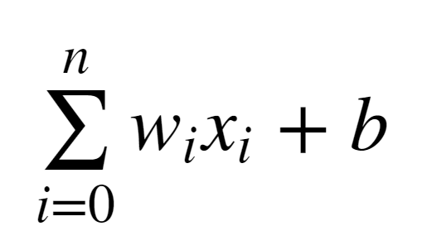
Deep Learning
Let’s quickly think about how we can represent this perceptron model mathematically:

Slide 27
Deep Learning
Once we have many perceptrons in a network we’ll see how we can easily extend this to a matrix form!

Slide 28
Deep Learning
Review
Biological Neuron
Perceptron Model
Mathematical Representation

Slide 29
Introduction to
Neural Networks

Slide 30
Deep Learning
We’ve seen how a single perceptron behaves, now let’s expand this concept to the idea of a neural network!
Let’s see how to connect many perceptrons together and then how to represent this mathematically!

Slide 31
Deep Learning
Multiple Perceptrons Network

Slide 32
Deep Learning
Input Layer. 2 hidden layers. Output Layer

Slide 33
Deep Learning
Input Layers
Real values from the data
Hidden Layers
Layers in between input and output
3 or more layers is “deep network”
Output Layer
Final estimate of the output

Slide 34
Deep Learning
As you go forwards through more layers, the level of abstraction increases.
Let’s now discuss the activation function in a little more detail!

Slide 35
Deep Learning
Previously our activation function was just a simple function that output 0 or 1.
1
Output
0
0
z = wx + b

Slide 36
Deep Learning
This is a pretty dramatic function, since small changes aren’t reflected.
1
Output
0
0
z = wx + b

Slide 37
Deep Learning
It would be nice if we could have a more dynamic function, for example the red line!
1
Output
0
0
z = wx + b

Slide 38
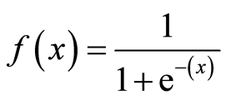
Deep Learning
Lucky for us, this is the sigmoid function!
1
Output
0
0
z = wx + b

Slide 39
Deep Learning
Changing the activation function used can be beneficial depending on the task!
1
Output
0
0
z = wx + b

Slide 40
Deep Learning
Let’s discuss a few more activation functions that we’ll encounter!
1
Output
0
0
z = wx + b

Slide 41
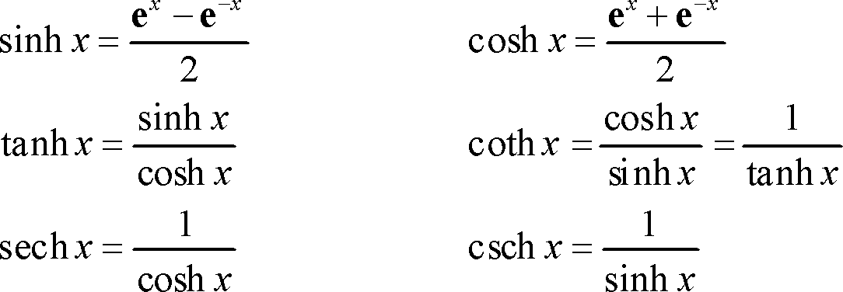
Deep Learning
Hyperbolic Tangent: tanh(z)
1
Output
-1
0
z = wx + b

Slide 42
Deep Learning
Rectified Linear Unit (ReLU): This is actually a relatively simple function: max(0,z)
Output
0
z = wx + b

Slide 43
Deep Learning
ReLu tends to have the best performance in many situations.
Deep Learning libraries have these built in for us, so we don’t need to worry about having to implement them manually!

Slide 44
Deep Learning
Now that we understand the basics of neural network theory, let’s move on to implementing and building our own neural network models with Keras!

Slide 45
Keras Basics

Slide 46
Natural Language Processing Bootcamp
Let’s learn how to create a very simple neural network for classifying the famous Iris data set!
The iris data set contains measurements of flower petals and sepals and has corresponding labels to one of three classes (3 flower species).

Slide 47
Recurrent Neural Networks Theory

Slide 48
Deep Learning
Examples of Sequences
Time Series Data (Sales)
Sentences
Audio
Car Trajectories
Music

Slide 49
Deep Learning
Let’s imagine a sequence:
[1,2,3,4,5,6]
Would you be able to predict a similar sequence shifted one time step into the future?
[2,3,4,5,6,7]

Slide 50
Deep Learning
Let’s imagine a sequence:
[1,2,3,4,5,6]
Would you be able to predict a similar sequence shifted one time step into the future?
[2,3,4,5,6,7]

Slide 51
Deep Learning
Normal Neuron in Feed Forward Network
Output
Activation Function
Σ
Aggregation of Inputs
Input

Slide 52
Deep Learning
Recurrent Neuron
Sends output back to itself!
Let’s see what this looks like over time!
Output
Σ
Input

Slide 53
Deep Learning
Recurrent Neuron
Output at t-1
Output at t
Output at t+1
Output
=
Σ
Σ
Σ
Σ
Input
Input
at t-1
Input at t
Input at t+1
Time

Slide 54
Deep Learning
Cells that are a function of inputs from previous time steps are also known as memory cells.
RNN are also flexible in their inputs and outputs, for both sequences and single vector values.

Slide 55
Deep Learning
We can also create entire layers of Recurrent Neurons...

Slide 56
Deep Learning
RNN Layer with 3 Neurons:
X
y

Slide 57
Deep Learning
“Unrolled” layer.
Output at t=0
Output at t+1
Output at t+2
Input
at t=0
Input at t+1
Input at t+2
Time

Slide 58
Deep Learning
RNN are also very flexible in their inputs and outputs.
Let’s see a few examples.

Slide 59
Deep Learning
Sequence to Sequence
Y₀
Y₁
Y₂
Y₃
Y₄
X₀
X₁
X₂
X₃
X₄

Slide 60
Deep Learning
Sequence to Vector
Y₀
Y₁
Y₂
Y₃
Y₄
X₀
X₁
X₂
X₃
X₄

Slide 61
Deep Learning
Vector to Sequence
Y₀
Y₁
Y₂
Y₃
Y₄
X₀
0
0
0
0

Slide 62
Deep Learning
Now that we understand basic RNNs we’ll move on to understanding a particular cell structure known as LSTM (Long Short Term Memory Units).

Slide 63
LSTM and GRU

Slide 64
Deep Learning
An issue RNN face is that after awhile the network will begin to “forget” the first inputs, as information is lost at each step going through the RNN.
We need some sort of “long-term memory” for our networks.

Slide 65
Deep Learning
The LSTM (Long Short-Term Memory) cell was created to help address these RNN issues.
Let’s go through how an LSTM cell works!
Keep in mind, there will be a lot of Math here! Check out the resource link for a full breakdown!

Slide 66
Deep Learning
A typical RNN
Output at t-1
Output at t
Output at t+1
Input
at t-1
Input at t
Input at t+1

Slide 67
Deep Learning
A typical RNN cell
Output at t-1
Output at t
Output at t+1
h_{t-1}
h_{t}
h_{t+1}
h_{t-1}
h_{t}
h_{t+1}
tanh
Input
at t-1
Input at t
Input at t+1

Slide 68
An LSTM Cell
Output at t
Here we can see the entire LSTM cell.
Let’s go through the process!
X
+
tanh
X
X
σ
σ
tanh
σ
Input at t
http://colah.github.io/posts/2015-08-Understanding-LSTMs/

Slide 69
An LSTM Cell
h_{t}
Here we can see the entire LSTM cell.
Let’s go through the process!
C_{t-1}
C_{t}
X
+
tanh
X
X
σ
σ
tanh
σ
h_{t-1}
h_{t}
x_{t}

Slide 70
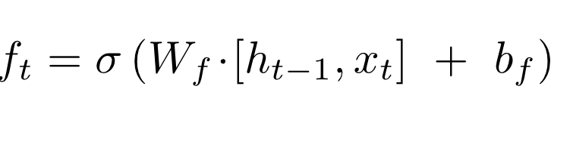
An LSTM Cell
h_{t}
C_{t-1}
C_{t}
X
+
tanh
f_{t}
X
X
σ
σ
tanh
σ
h_{t-1}
h_{t}
x_{t}

Slide 71
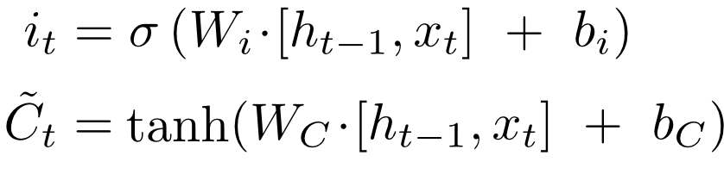
An LSTM Cell
h_{t}
C_{t-1}
C_{t}
X
+
tanh
i_{t}
X
~
C_{t}
X
σ
σ
tanh
σ
h_{t-1}
h_{t}
x_{t}

Slide 72
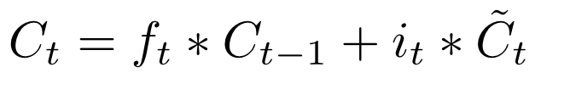
An LSTM Cell
h_{t}
C_{t-1}
C_{t}
X
+
tanh
f_{t}
i_{t}
X
~
C_{t}
X
σ
σ
tanh
σ
h_{t-1}
h_{t}
x_{t}

Slide 73
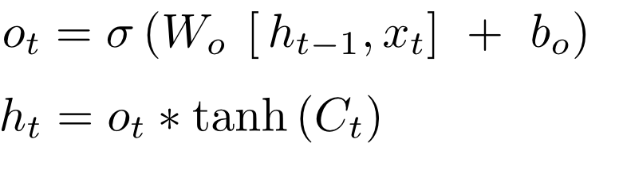
An LSTM Cell
h_{t}
C_{t-1}
C_{t}
X
+
tanh
X
X
σ
σ
tanh
σ
h_{t-1}
h_{t}
x_{t}

Slide 74
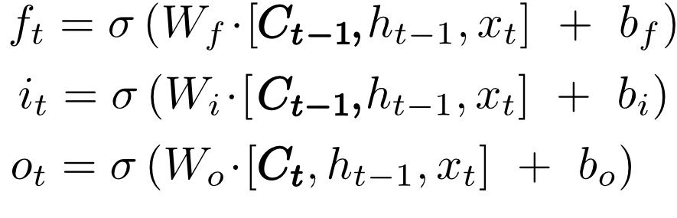
An LSTM Cell with “peepholes”
h_{t}
C_{t-1}
C_{t}
X
+
tanh
X
X
σ
σ
tanh
σ
h_{t-1}
h_{t}
x_{t}

Slide 75
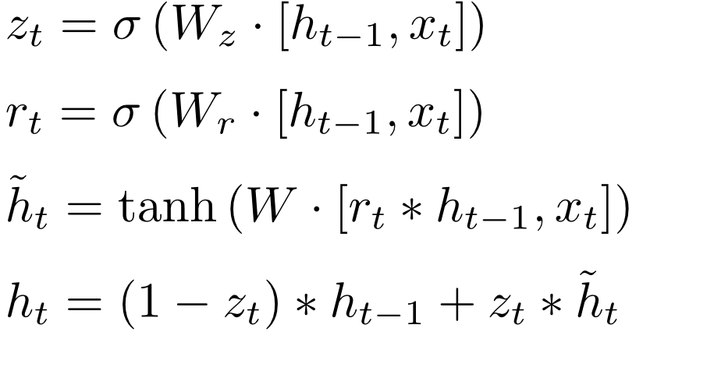
Gated Recurrent Unit (GRU)
h_{t}
h_{t-1}
C_{t}
X
+
X
r_{t}
1-
z_{t}
X
σ
σ
tanh
x_{t}

Slide 76
Deep Learning
Fortunately Keras has a really nice API that makes LSTM and RNN easy to work with.
Coming up next, we’ll learn how to format data for RNNs and then how to use LSTM for text generation.

Slide 77
Text Generation
With Python and Keras
Part One

Slide 78
Natural Language Processing Bootcamp
Process Text
Clean Text
Tokenize the Text and create Sequences with Keras

Slide 79
Text Generation
With Python and Keras
Part Two

Slide 80
Natural Language Processing Bootcamp
Create the LSTM Based Model
Split the Data into Features and Labels
X Features (First n words of Sequence)
Y Label (Next Word after the sequence)
Fit the Model

Slide 81
Text Generation
With Python and Keras
Part Three

Slide 82
Natural Language Processing Bootcamp
Generate New Text Based off a Seed

Slide 83
Deep Learning QA Bot

Slide 84
Natural Language Processing Bootcamp
We will be implementing a chat bot that can answer questions based on a “story” given to the bot.
We will use the BaBi dataset released by Facebook research.
https://research.fb.com/downloads/babi/

Slide 85
Natural Language Processing Bootcamp
Story
Jane went to the store. Mike ran to the bedroom.
Question
Is Mike in the store?
Answer
No

Slide 86
Natural Language Processing Bootcamp
End-to-End Memory Networks
Sainbayar Sukhbaatar
Arthur Szlam
Jason Weston
Rob Fergus
You must read the paper to understand this network!

Slide 87
How the QA Bot Network Works
Model takes a discrete set of inputs x1, ..., xn that are to be stored in the memory, a query q, and outputs an answer a
Each of the x , q, and a contains symbols coming from a dictionary with V words.
The model writes all x to the memory up to a fixed buffer size, and then finds a continuous representation for the x and q.

Slide 88
How the QA Bot Network Works
End to End Network:
Input Memory Representation
Output Memory Representation
Generating Final Prediction
Create a full model with RNN and Multiple Layers

Slide 89
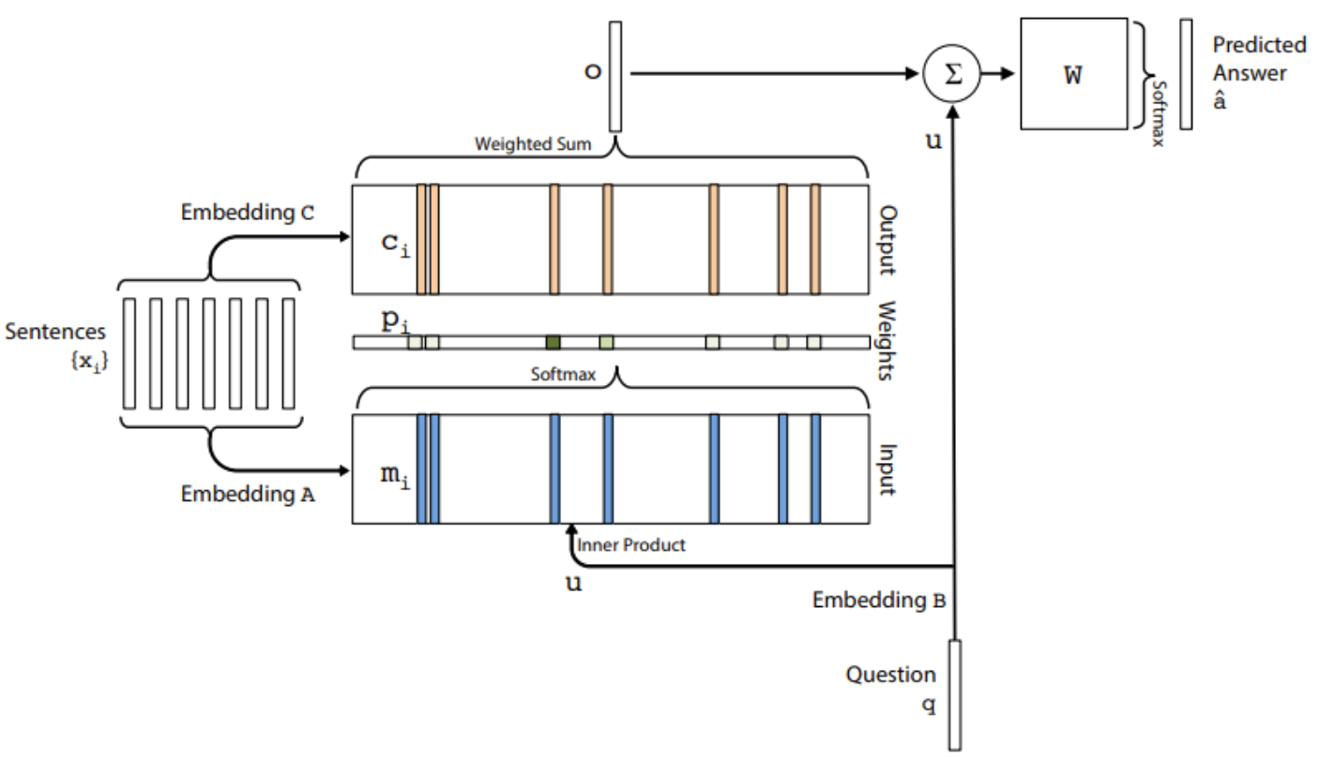
How the QA Bot Network Works
Input Memory Representation of stories.
Use Keras for Embedding to convert sentences x
Encoders C and M
Question Encoder

Slide 90


How the QA Bot Network Works
Input Memory Representation of stories.

Slide 91
How the QA Bot Network Works
Output Memory Representation
Each x has a corresponding output vector c

Slide 92

How the QA Bot Network Works
Output Memory Representation

Slide 93

How the QA Bot Network Works
In the single layer case, the sum of the output vector o and the input embedding u is then passed through a final weight matrix W (of size V × d) and a softmax to produce the predicted label:

Slide 94
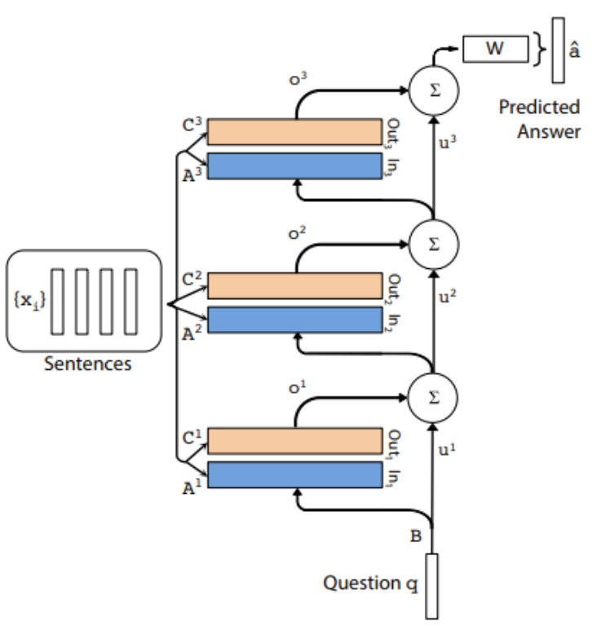
How the QA Bot Network Works

Slide 95
How the QA Bot Network Works
Let’s begin exploring how we can build out this network with Python and Keras!

Slide 96
Q&A Bot with Python
Part Two

Slide 97
Natural Language Processing Bootcamp
Understand the steps on how to Vectorize the Data
Create a function that can vectorize data for us.

Slide 98
Q&A Bot with Python
Part Three

Slide 99
Natural Language Processing Bootcamp
Make sure to read the paper before continuing to this lecture!

Slide 100
Natural Language Processing Bootcamp
Build the Neural Network
Input Encoder M
Input Encoder C
Question Encoder
Complete the Network

Slide 101
Q&A Bot with Python
Part Four

Slide 102
Natural Language Processing Bootcamp
Fit/Train the network
(We will load a pre-trained network)
Plot out Training History
Evaluate on Test Set
Create our Own Stories and Questions

